Slide 1
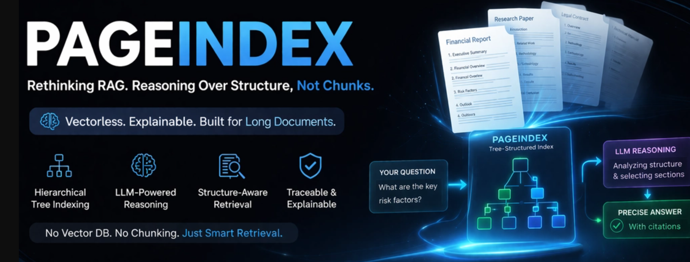

Slide 2
01
Vector-Based vs Vectorless RAG
Different approaches.
Different strengths.
Different outcomes

Slide 3
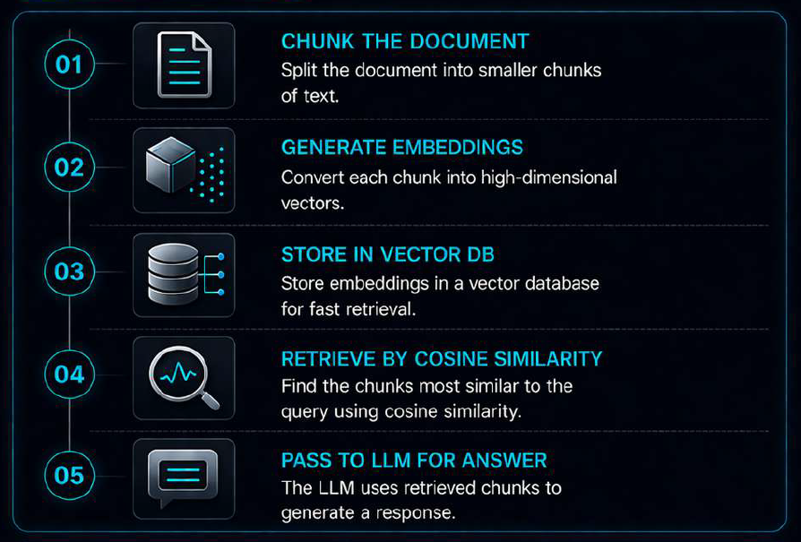

02
How Most Teams Build RAG Today

Slide 4
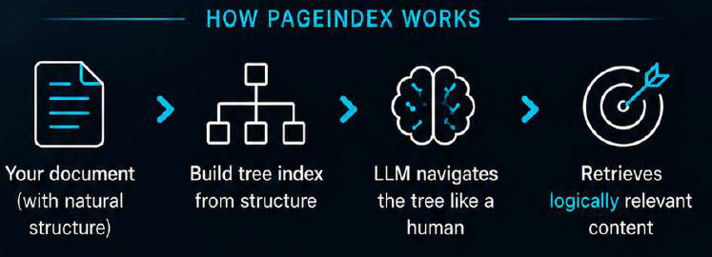
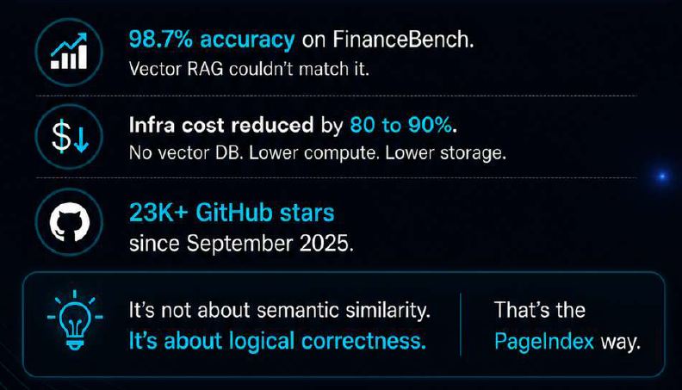
03
PageIndex replaces chunking, embedding and vector db entirely

Slide 5
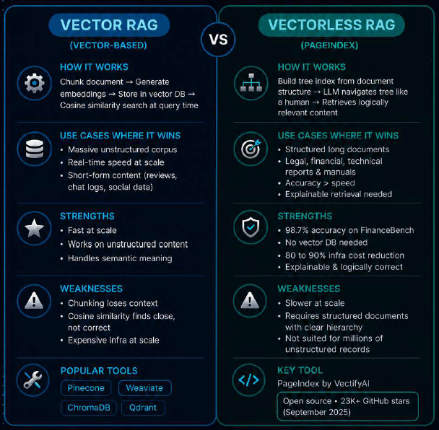

04
So which one belongs where?

Slide 6
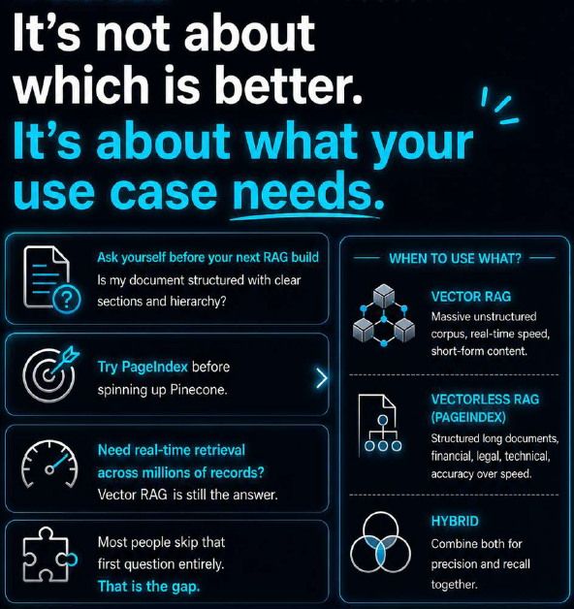
05

